Slide 1
NARI SURAKSHA
Bhagyasree YESUGOL shruti MADALBHAVI darshana MELAGE KHUSHI CHOUGULE pooja NESARAGI

Slide 2
INTRODUCTION OF TEAM bhagyasree shruti darshana KHUSHI pooja

Slide 3
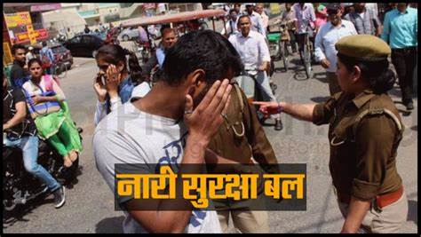

Slide 4

Please save girls
Save India

Slide 5
INTRODUCTION As we all know there is big problem in India such as raping, kidnyaping etc.Our website is used for the protection of women, girls .

